Slide 1
Medical and Psychological Issues for Female Service Members
Elspeth Cameron Ritchie, MD, MPH, Chief Medical Officer
Department of Behavioral Health, Washington, DC

Slide 2
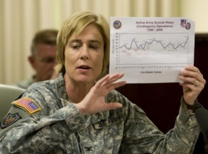
Disclosure
The views expressed in this presentation are those of the presenter and do not reflect the official policy of the Defense Department or the U.S. government or Wash DC.
I have no relevant financial relationships to disclose
I do intend to briefly discuss the off-label/ investigative (unapproved) use of commercial products or devices on slide 24.
2

Slide 3
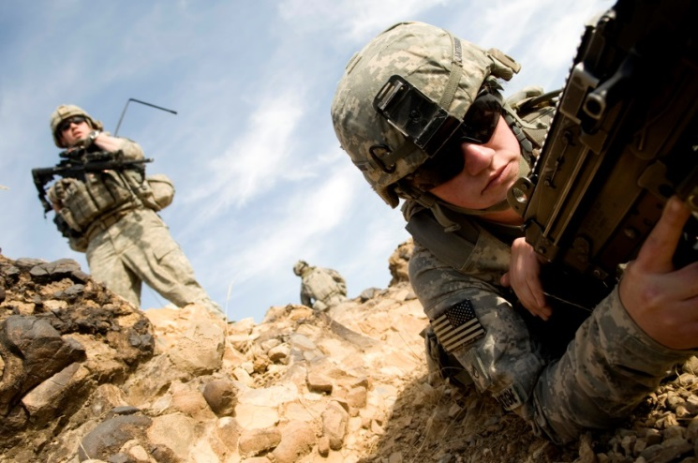
Objectives
Review the effects of combat on psychological health.
Explain the rigors of maintaining proper nutritional and gynecological health in a deployed environment.
Communicate issues around sexuality and motherhood with service members

Slide 4
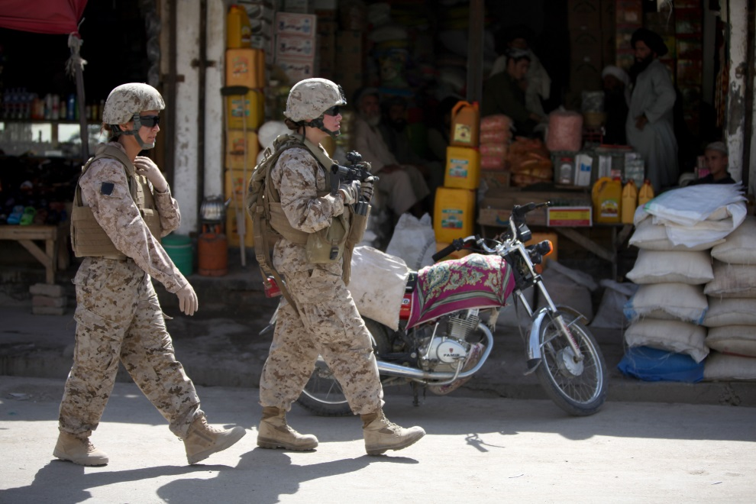
Outline
Credentials
Garrison vs field vs deployment vs combat
Medical Issues
Psychological Issues
Focus on sexual assault

Slide 5
My credentials
Experience
24 years active duty
Deployments to Korea, Somalia, Iraq, Cuba
Mental health and Women’s health issues at Health Affairs 1999-2003
Psychiatry Consultant, work at OTSG 2005-2010
Publications on Women’s Health Issues
Reactions to Rape: A Military Forensic Psychiatrists Perspective. Military Medicine, Aug 1998
Issues for Military Women in Deployment. Military Medicine, Dec 2001
Breastfeeding in the Military. Part I: Information and Resources Provided to Servicewomen. Military Medicine, October 2003.
Breastfeeding in the Military. Part II: Resource and Policy Considerations. Military Medicine, October 2003.
Sexual Abuse and Female Recruits, 2006,
Women in Combat, Psych Annals, April, 2014.
Women at War. Oxford University Press, in press.

Slide 6
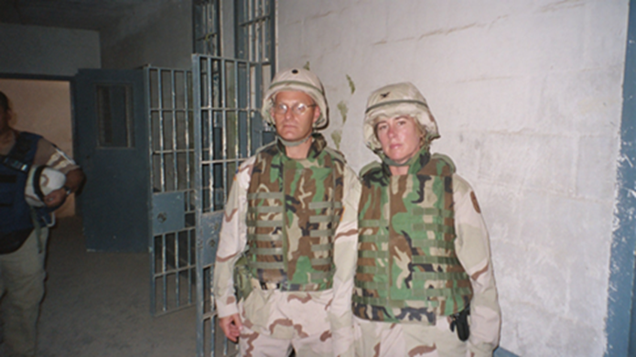
Special Issues for Female Service Members
Reproductive
Pregnancy
Breastfeeding
Musculoskeletal
Stress fractures
Deployment Health
Urinary tract infections
Dehydration
Menstruation
Psychological reactions
Evacuations from theatre for PTSD
Treatment for PTSD
Sexual assault

Slide 7
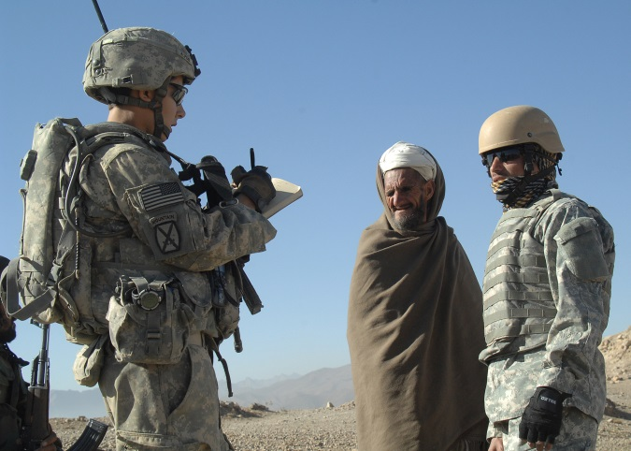
Reproductive Issues
Pregnancy (garrison)
Physical training
Deployment
Exposure to toxins
Breast-feeding (garrison, field)
Maintenance of breast feeding
Exposure to petroleum products
Motherhood (garrison, field, deployment, combat)

Slide 8
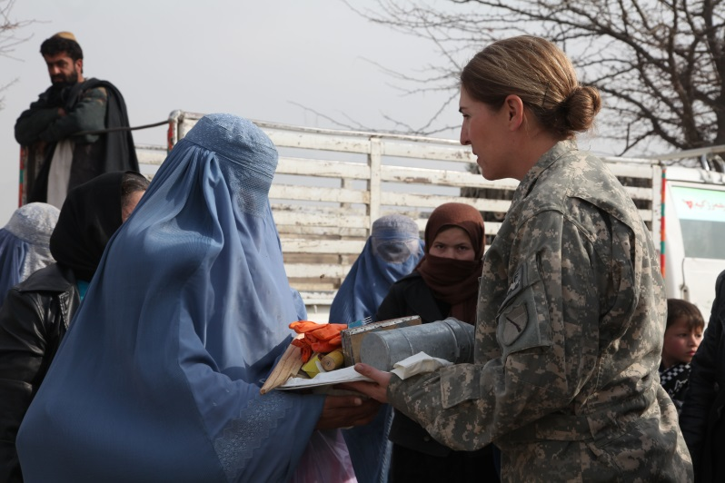
Musculoskeletal issues
Heavy personal equipment
Kevlar helmets
Body armor
Stress fractures
Pelvic
Special issues for recruits
Personal strength

Slide 9
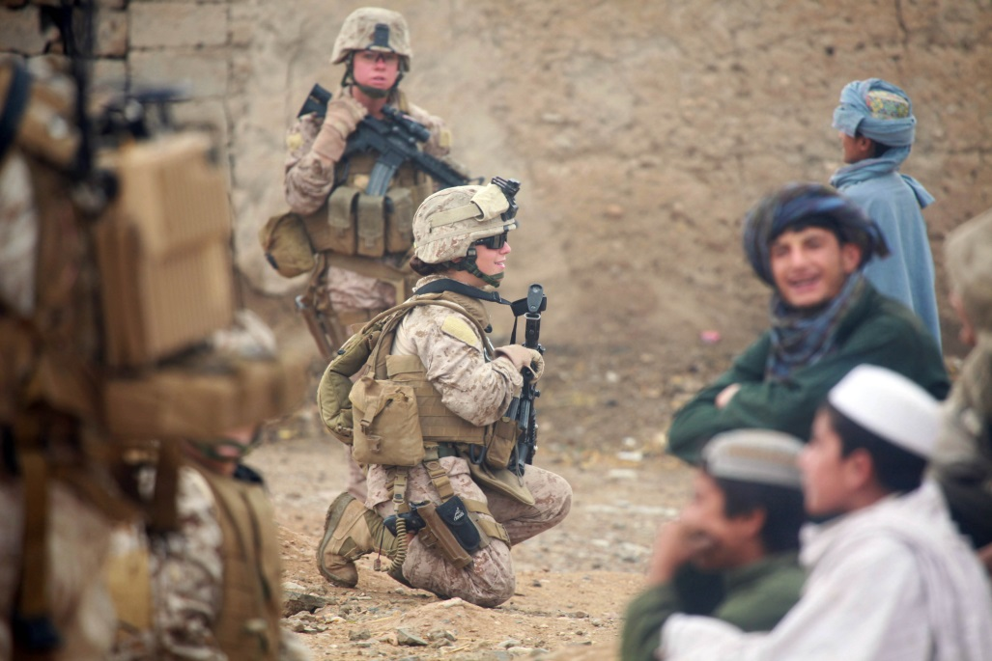
Deployment Health
Genito-urinary issues
Lack of clean bathrooms
Bombs by the side of the road
Fluid restriction
Dehydration
Menstruation
Regulating
Suppressing
Birth control

Slide 10
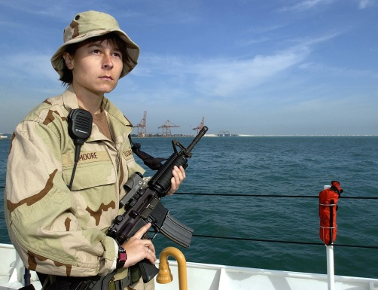
Deployment vs Combat
Women in deployment
“Issues for Military Women in Deployment” Bathrooms, pregnancy, breast-feeding, home front problems
Women in combat
Women’s Health Task Force report from Afghanistan Bathrooms (see next slides)
Body armor
Home front issues
PTSD
TBI
http://www.globalsecurity.org/military/library/report/2011/womens-concerns-afghanistan.pdf

Slide 11
Women’s Health Task Force
Issues women face while in austere environments that AFFECT their health
How to urinate in the field
Maintaining urogenital hygiene
Managing menstruation in field environment
Managing lactation in the field
Improper fit of uniform
http://www.globalsecurity.org/military/library/report/2011/womens-concerns-afghanistan.pdf

Slide 12
Women’s Health Task Force http://www.globalsecurity.org/military/library/report/2011/womens-concerns-afghanistan.pdf
Dealing with female health issues in an austere environment
Levels of care / providers
Menstrual dysfunction
Urogenital infections
Access to birth control
Unintended pregnancy

Slide 13
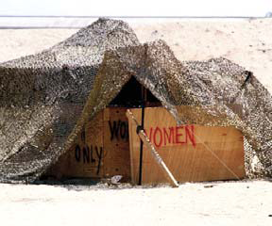
Military Medical Culture and Women
Military Medicine
Many women in medical roles
Deployed hospitals relatively female friendly
Further forward medical units often austere
May have very few women
Photo courtesy of COL (ret.) Elspeth Ritchie

Slide 14
Research on Mental Health of Deployed Women
Minimal Research
Most Mental Health Advisory Teams focus on men
MHAT II (2005) showed essentially equal rates in PTSD in women (12%) and men (13%) (https://timemilitary.files.wordpress.com/2012/07/2-oif-ii_report-105.pdf)
Millennium Cohort Study
Evacuations for Behavioral Health reasons
Female PTSD rates in OIF OEF 2001 to 2013
Courtesy of Dr. Mike Carino, staff officer, Office of the Army Surgeon General
Army data 2003-2013

Slide 15
Female PTSD Percentages in OIF OEF from 2001 to 2013.

Slide 16
PTSD DSM IV Diagnostic Concept
Traumatic experience leads to:
Threat of death/serious injury
Intense fear, helplessness or horror
Symptoms (3 main types)
Reexperiencing the trauma (flashbacks, intrusive thoughts)
Numbing & avoidance (social isolation)
Physiologic arousal (“fight or flight”)
Which may cause impairment in
Social or occupational functioning
Persistence of symptoms
Notes:
16
There are four main parts to the concept of PTSD. The first two are unique to PTSD. The second two (impaired function and persistence of symptoms and functional impairment) are common to most psychiatric disorders.
Traumatic experiences are very common to Soldiers in Iraq and Afghanistan, however most Soldiers having traumatic experiences do not develop a disorder.
Also, keep in mind that while we are focusing most on war trauma, there will be Soldiers who experience other kinds of trauma such as in the civilian world (rape, abuse, motor vehicle accidents, etc.).

Slide 17
DSM 5 Definition of PTSD
Removes Criterion A-2
Additional criteria
Somatic reactions
Sleep
Depressive symptoms
Anger and irritability

Slide 18
Evidence Based Approaches for PTSD
Psychotherapy
Cognitive behavioral therapy
Cognitive processing therapy
Prolonged exposure
Pharmacotherapy
SSRIs

Slide 19
New and Innovative Approaches
Other Pharmacotherapies
2nd Generation Antipsychotics
Integrative therapies
Acupuncture
Stellate ganglion block
Yoga
Canine therapy
Technology
Virtual reality

Slide 20
Evidence Based Approaches for PTSD: Psychotherapy
“Manualized” therapies have been shown effective in research trials. The two most common are 1) Cognitive behavioral therapy (and a variant called cognitive processing therapy) and 2) Prolonged exposure.
These are usually delivered by psychologists and social workers. Most are readily available in military and Veteran’s Affairs settings.
A computer variation of prolonged exposure is called “virtual reality”. This may be self-administered via computer. “Virtual Iraq” is simulated on the computer screen.
Notes:
This slide could be put in notes with an art therapy picture.

Slide 21
Pharmacotherapy
Pharmacotherapy evidence based approaches: include the SSRIs sertaline (Zoloft) and paroxetine (Paxil). Those two are FDA approved. However other SSRIs are commonly used for PTSD.
Sexual side-effects may be a problem, especially for young male service members.
Second generation (atypical) anti-psychotics are often used both for depression and PTSD, to augment other antidepressants. While controversial, clinicians find low doses useful. For example, quetiapine (Seroquel) is commonly used for trauma induced nightmares at low doses of 25 to 50 mgs. However these medications may cause unacceptable weight gain, so use sparingly.
Prazocin, a blood pressure medication, is also used to decrease nightmares.It is prescribed at a lower dose than for blood pressure.
Bupropion (Wellbutrin) is often well tolerated without the weight gain.
Notes:
This slide could be put in notes with an art therapy picture.

Slide 22
Sleep medications
Insomnia is extremely common in PTSD. Improving sleep is critically important to recovery.
Consider standard sleep medications, such as Trazodone 100 mgs (warn re priapism). Zolpidem (ambien) is often used. Warn about interactions with alcohol, other sedating medications.
Avoid benzodiazapines, especially alprazolam (Xanax) because of the short half-life.
Notes:
This slide could be put in notes with an art therapy picture.

Slide 23
Innovative Approaches
Complementary and Alternative or Integrative therapies are anecdotally very helpful but not yet evidence based. They are Available at some military, veterans affairs and civilian facilities.
Acupuncture probably has the best evidence base for use in PTSD
Stellate ganglion block is an Anesthetic technique for pain seems to relieve PTSD symptoms.
Other strategies include yoga, marital arts and other physical techniques, meditation and/or mindfulness and canine therapy.
Notes:
See series in “Psychiatric Annals” Jan to July 2013.

Slide 24
Clinical pearls
The following are not currently FDA approved, but are options that some clinicians have noted success when using/combining,”
If there is sexual dysfunction from SSRIs, add bupropion (Wellbutrin).
If PTSD related anxiety, try propranolol (Inderal).
Again quetiapine and prazocin are helpful to decrease nightmares.
Combine medication, psychotherapy and innovative approaches.
Notes:
This slide could be put in notes with an art therapy picture.

Slide 25
Co-morbidities
The following are all very common with PTSD: substance use, depression and physical injuries with associated pain (including TBI).
Unfortunately, after Vietnam, too many veterans slid into unemployment and homelessness.
Many states are developing action plans to try to prevent that deteriorations. These focus on health care, employment, housing, education and the criminal justice system.
Notes:
This slide could be put in notes with an art therapy picture.

Slide 26
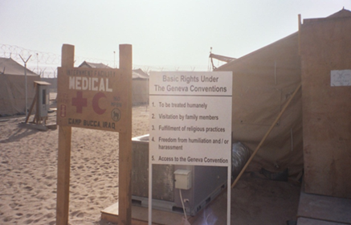
Sexual Assault: Background
Persistent problem
Varying definitions
Sexual trauma, sexual assault, harassment, rape
Different data depending on source
Sexual Assault Prevention and Response Office
Website http://sapr.mil/index.php/news
Photo courtesy of COL (Ret.) Elspeth Ritchie

Slide 27
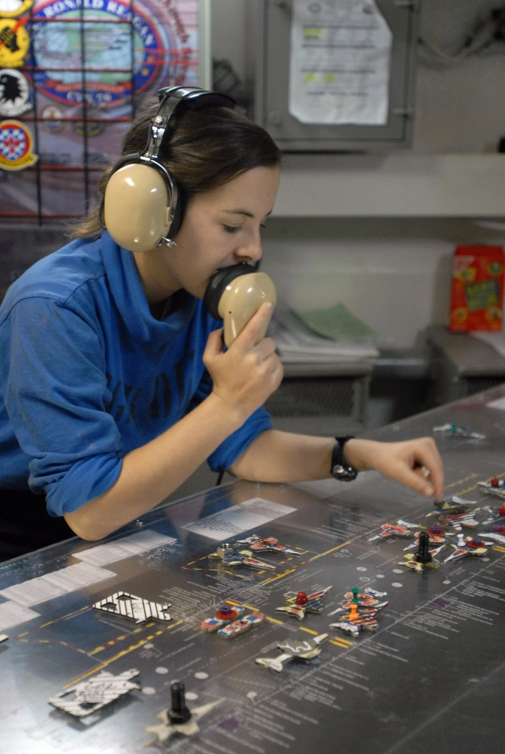
Many perspectives
Medical
Leader
Subject matter expert
Victim advocate
Legal
Defense
Prosecution

Slide 28
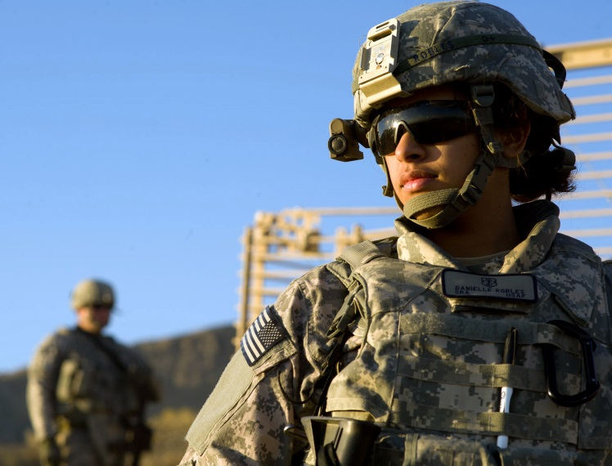
Ways to View the Problem
Individual vulnerability
Unintended consequence
Often related to alcohol
Sexual predator
Leadership failure
Occupational hazard
Environmental contribution

Slide 29
Individual Vulnerability
Victim often had prior risk factors
Impulsiveness
Prior history of abuse
Alcohol or drug use
Marginal Soldier
No one to confide in
Afterwards
Too embarrassed to tell
Photo courtesy of COL (Ret.) Elspeth Ritchie

Slide 30
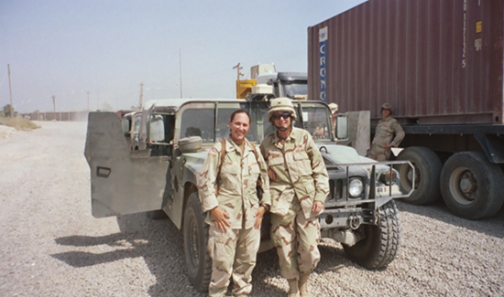
Unfortunate event
Begins as date or party
Alcohol often involved
Something happens
“He said-she said” Photo Courtesy of COL (Ret) Elspeth Ritchie
Usually he says it was voluntary and she says it was not or that she was too drunk to remember
Caveat: men can also be victims and women perpetrators
Both end up as victims
Usually she leaves the Army
If convicted he goes to jail

Slide 31
Sexual predator
Often power imbalance
Recruiter, drill sergeant
Older, higher rank
May select and groom vulnerable victim
May use force, but seldom uses weapons
Threatens her if she tells
She will get into trouble
Caveat: men can also be victims and women perpetuators

Slide 32
Leadership Failure
May occur in chaotic units
poor discipline
porous boundaries
“Lord of the Flies”
Rapid turnover in basic training
Trainees just want to graduate
Leader may ignore warning signs
Leader may collude in behavior

Slide 33
Environmental Problem
Remote locations
Coast Guard station
Aberdeen
Recruiter’s office
Secluded area
Park bench
Latrines
Jail cell
No one there to tell
Photo courtesy of COL (Ret.) Elspeth Ritchie

Slide 34
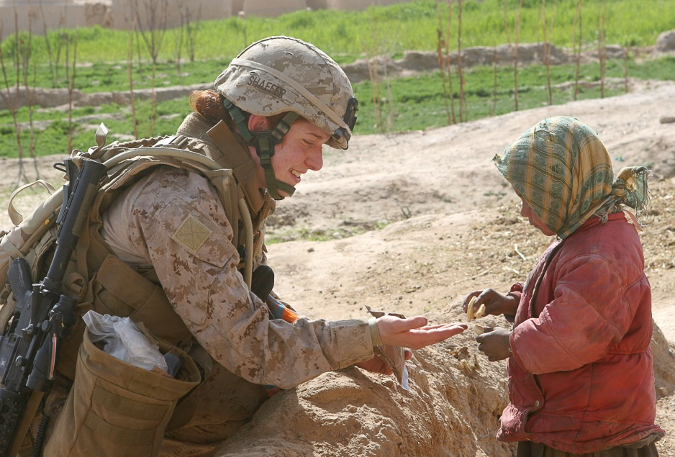
Overall Recommendations
Several gaps in policy
Training for all service members on women’s issues
Many gaps in research that merit further study
Urinary tract infections impact on readiness
TBI and PTSD gender specific issues

Slide 35
Conclusions
More attention needs to be paid to issues of female reproductive and urogenital health
Lack of clean facilities degrade ability of women in deployment and combat
Health planners need to anticipate deployed women
BLUF: let us develop an organized approach to solving these problems

Slide 36
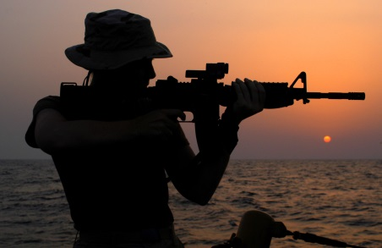
Questions/Discussion
Lt. Holly Harrison, Commanding Officer of the U.S. Coast Guard Cutter Aquidneck (WPB 1309) sights in on a target with an M-4 rifle during small arms refresher training onboard the cutter which is one of four 110-foot patrol boats continuing to perform missions in support of Operation Iraqi Freedom, Arabian Gulf, June 23, 2003.
US Coast Guard photo by PA1 John Gaffney

Slide 37
References
Naclerio, A., Stola, J., Tergo, L., & Flaherty, E. (2011). The Concerns of Women Currently Serving in the Afghanistan Theater Operations. http://www.globalsecurity.org/military/library/report/2011/womens-concerns-afghanistan.pdf
Ritchie, E (1998). Reactions to Rape: A Military Forensic Psychiatrists Perspective. Military Medicine, 163 (8) 505-9.
Ritchie, E., Best, C., Pierce, M., & Everest, T. Sexual Abuse and Female Recruits (2006).Textbook of Military Medicine, Chapter 21

